Slide 1
Pandemic Preparedness and Economic Performance
Dr. Tobias Dieler and Gautam Vyas

Slide 2
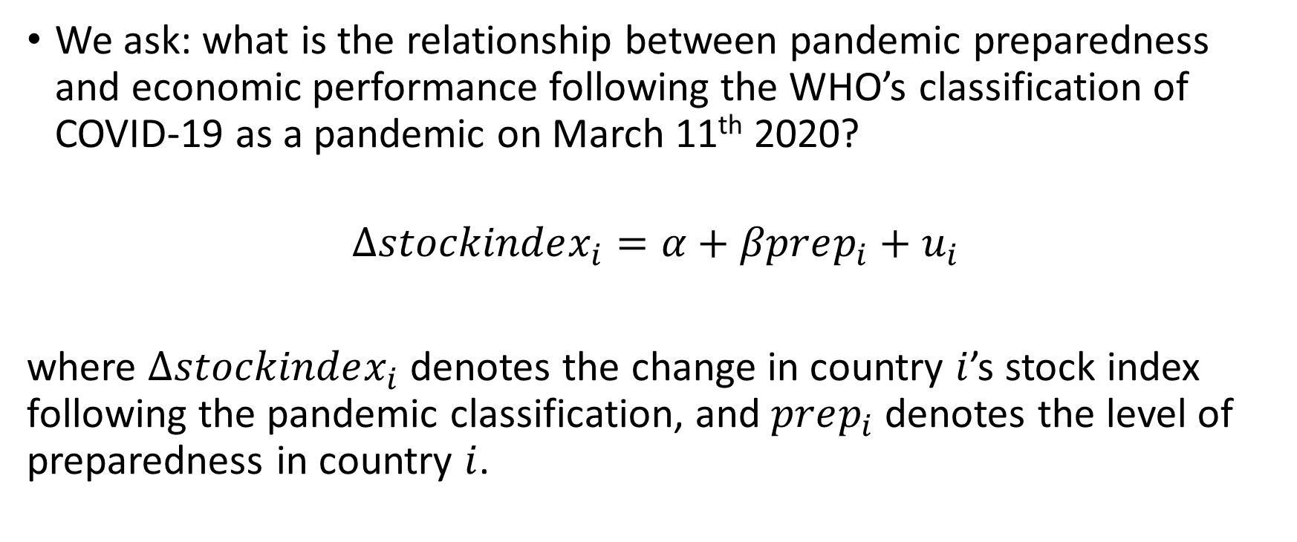
Introduction
We ask: what is the relationship between pandemic preparedness and economic performance following the WHO’s classification of COVID-19 as a pandemic on March 11th 2020?
$$∆stockindex_{i}=α+βprep_{i}+u_{i}$$
where $∆stockindex_{i}$ denotes the change in country $i$’s stock index following the pandemic classification, and $prep_{i}$ denotes the level of preparedness in country $i$.

Slide 3
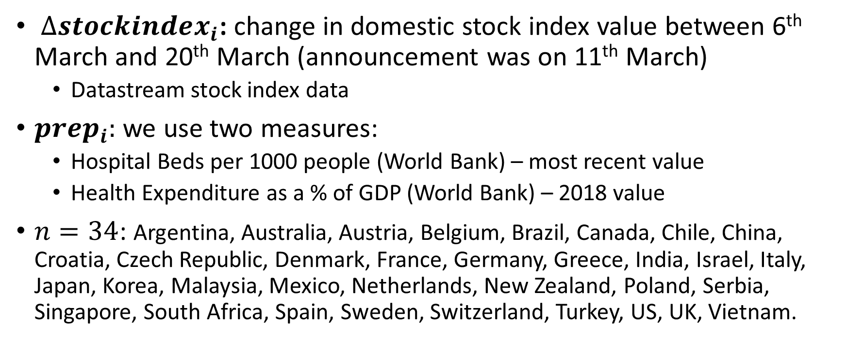
Data
$∆stockindex_{i}$: change in domestic stock index value between 6th March and 20th March (announcement was on 11th March)
Datastream stock index data
$prep_{i}:$ we use two measures:
Hospital Beds per 1000 people (World Bank) – most recent value
Health Expenditure as a % of GDP (World Bank) – 2018 value
$n=34$: Argentina, Australia, Austria, Belgium, Brazil, Canada, Chile, China, Croatia, Czech Republic, Denmark, France, Germany, Greece, India, Israel, Italy, Japan, Korea, Malaysia, Mexico, Netherlands, New Zealand, Poland, Serbia, Singapore, South Africa, Spain, Sweden, Switzerland, Turkey, US, UK, Vietnam.

Slide 4
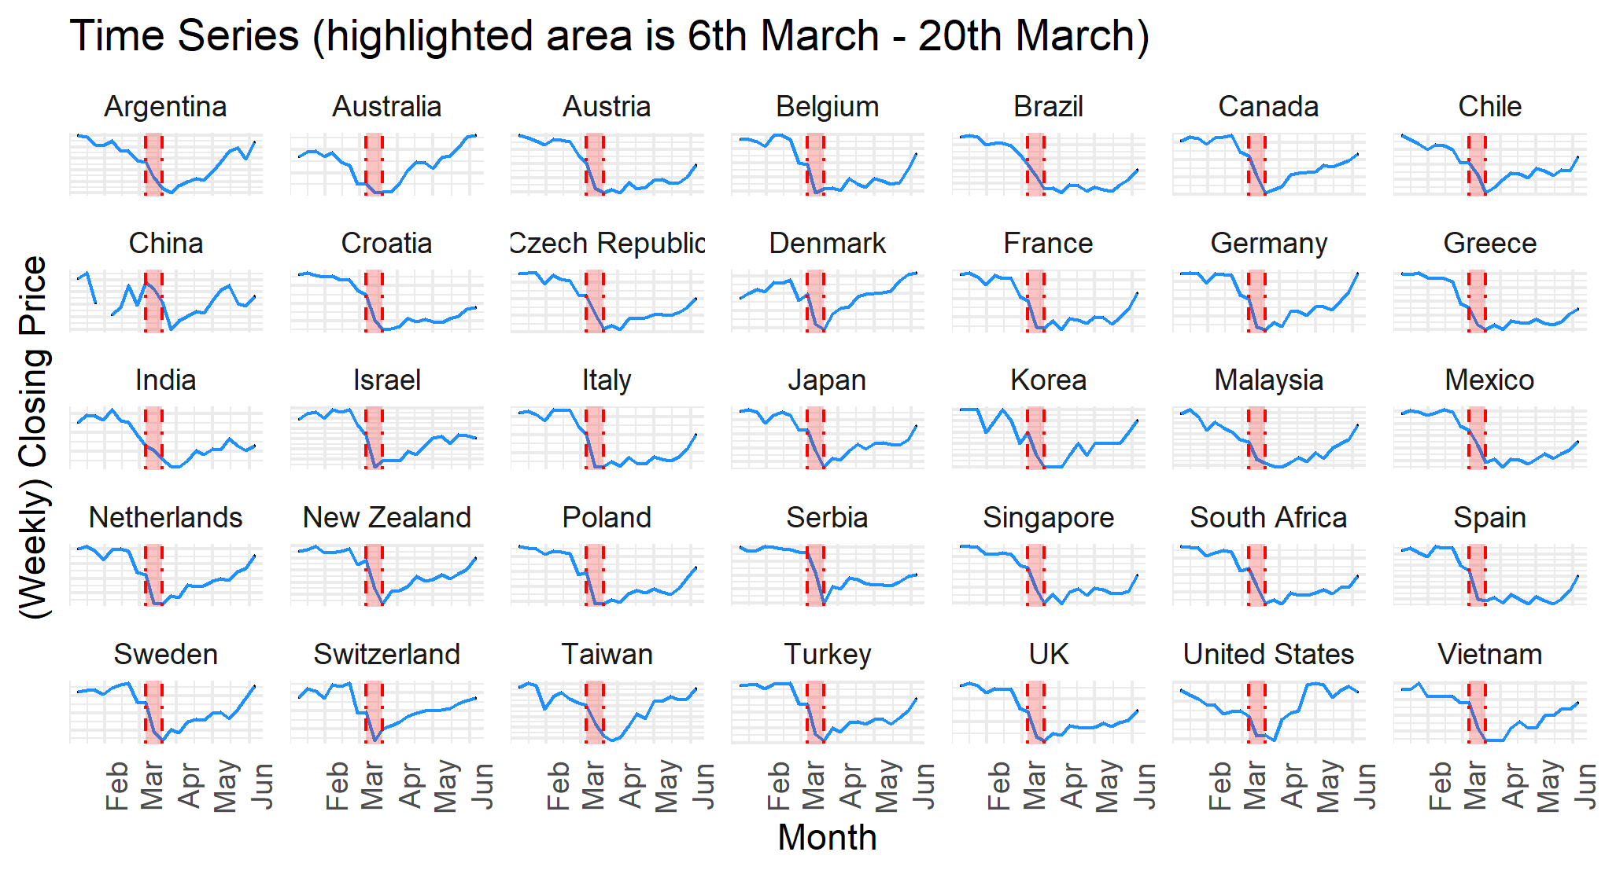
Domestic Stock Indices: Absolute Changes
Notes:
Taiwan – we have stock data but no X variable data, hence N = 35 here.

Slide 5
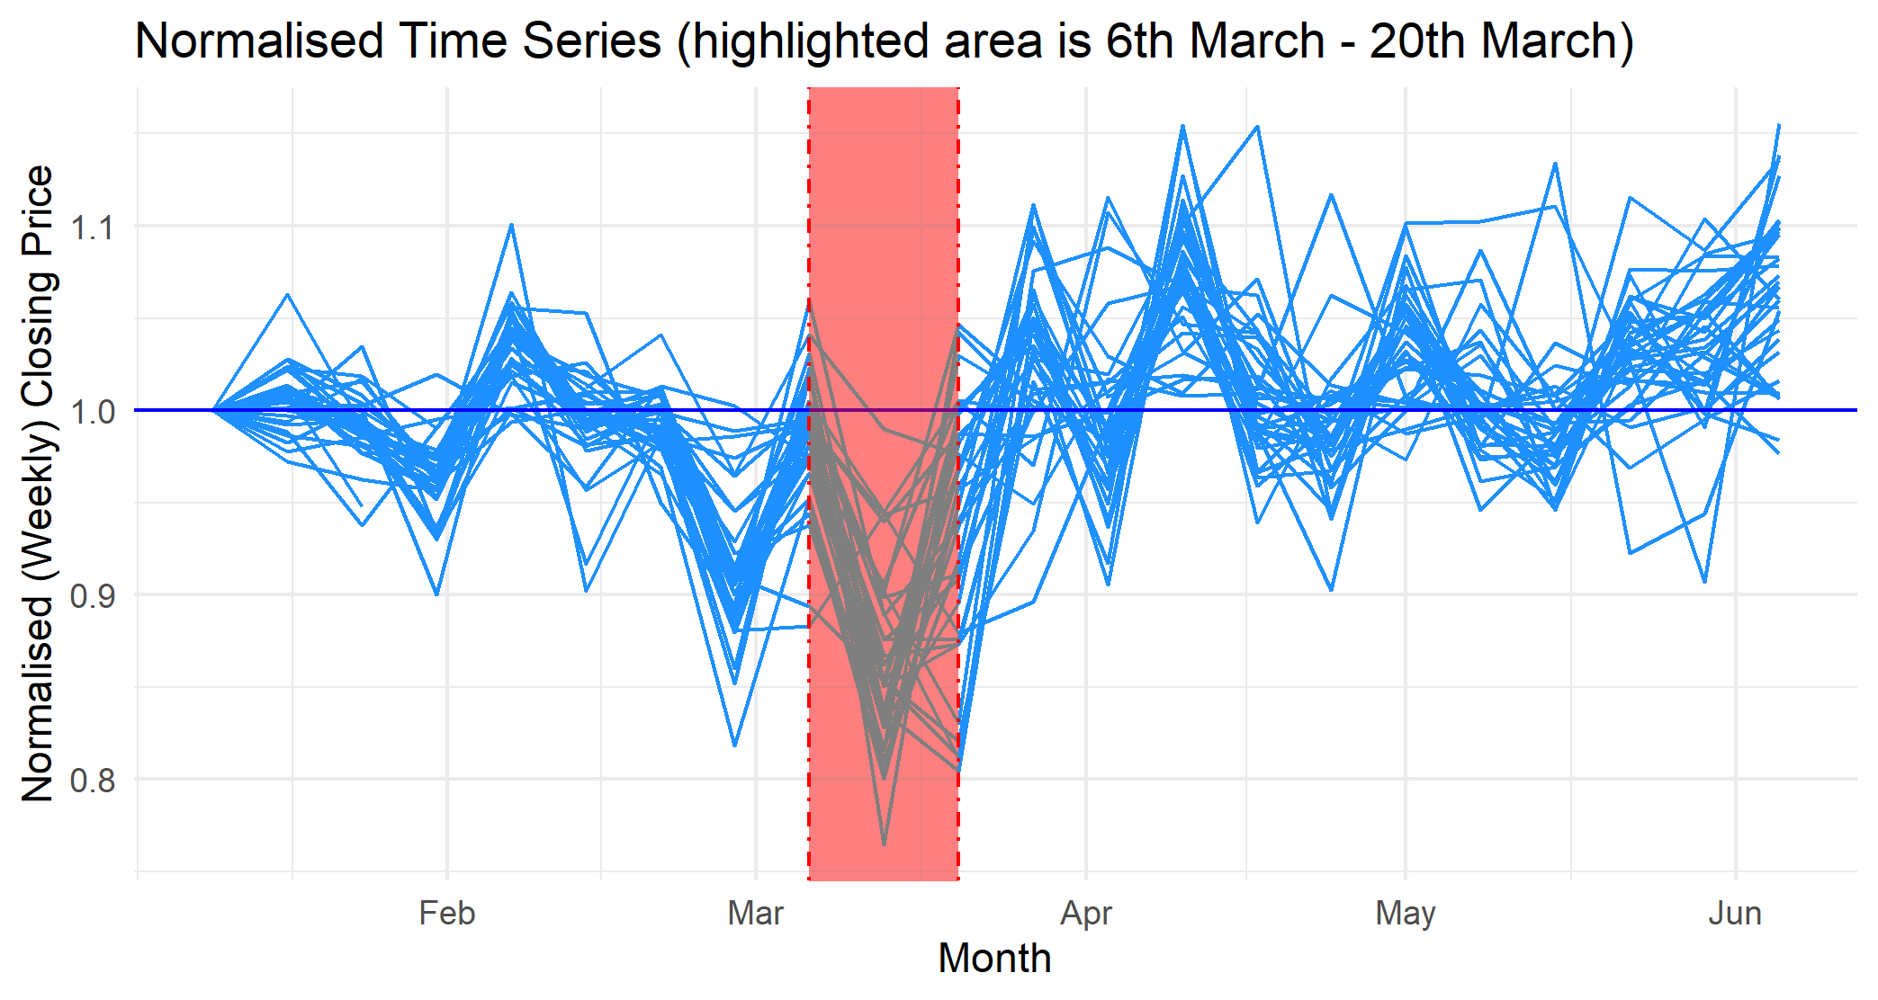
Domestic Stock Indices: Relative Changes
Notes:
Interpretation: all stock indices are normalised to 1 in the first week, then the percentage changes are implemented. All datapoints above the horizontal line at 1 indicate a rise in the stock index in that week; all values below 1 indicate a fall in the stock index in that week. Key here: note how the vast majority of data points between 6th-20th March are below the line!

Slide 6
Hospital Beds Per 1000

Slide 7
Health Expenditure (as a % of GDP)

Slide 8
Analysis 1: Hospital Beds and Stock Performance

Slide 9
Results: Hospital Beds and Stock Performance

Slide 10
Analysis 2: Health Expenditure and Stock Performance

Slide 11
Results: Health Expenditure and Stock Performance

Slide 12
Way forward
Government announcement of first case (source: EIKON, WHO, WTO, IMF ?!)
DID: Find a date around which a group of countries had announced their first case (treatment group) and compare to the group who had not announced the first case yet
Staggered DID: At any announcement date compare the group (only the country?) that already announced the first case to the one which just announced the first case.

Slide 13
Hospital Beds and Stock Index Performance 2

Slide 14
Results

Slide 15
Health Expenditure and Stock Performance 2

Slide 16
Results

